Slide 1
《数据科学理论与实践》之 数据产品及开发
朝乐门
中国人民大学
chaolemen@ruc.edu.cn

Slide 2
8.如何继续学习
▲7.案例分析
▼9.本专题习题

Slide 3
5.9 如何继续学习
朝乐门
中国人民大学
chaolemen@ruc.edu.cn

Slide 4
继续学习建议
▼第5章【数据产品及开发】
►如何继续学习
学好本章的重要意义
数据产品开发是数据科学家的核心竞争力之源，也是数据科学中独有的知识内容。因此，学好数据产品开发相关的知识是数据科学中不可忽略的核心内容之一。
继续学习方法
数据产品开发不仅涉及理论学习与实践经验，更重要的是数据科学家的3C精神的培养。因此，建议在后续学习中不仅要重视基础理论和最佳实践的跟踪，而且也应重视与领域高端人才的合作与沟通，如参加开源项目、活跃于各大专业社区等。
提醒及注意事项
正确理解数据产品的本质特征是学习好本章知识的关键所在；培养自己的数据科学家精神与素质——创造性设计、批判性思考、好奇性提问是我们继续学习本章的首要任务。
与其他章节的关系
本章是“第一章 基础理论”的进一步深入讲解，系统讲解了数据产品开发的方法与内容。“第六章 典型案例及实践”是本章拓展，建议结合典型实践理解数据产品开发的知识。

Slide 5
经典文献选读
▼第5章【数据产品及开发】
►如何继续学习
Use product design
When in doubt, use humans
Be opportunistic for wins
Ground your product in the real world
Give data back to the user to create additional value
No data vomit
Expect unforeseen side effects
Improving precision and recall
Subjectivity
Enlisting other users
Ask and you shall receive
Anticipate failure
Putting Data Jujitsu into practice

Slide 6
经典文献选读
▼第5章【数据产品及开发】
►如何继续学习
1 A new paradigm for Big Data
PART 1 BATCH LAYER
2 Data model for Big Data
3 Data model for Big Data: Illustration
4 Data storage on the batch layer
5 Data storage on the batch layer: Illustration
6 Batch layer
7 Batch layer: Illustration
8 An example batch layer: Architecture and algorithms
9 An example batch layer: Implementation
PART 2 SERVING LAYER
10 Serving layer
11 Serving layer: Illustration
PART 3 SPEED LAYER
12 Realtime views
13 Realtime views: Illustration
14 Queuing and stream processing
15 Queuing and stream processing: Illustration
16 Micro-batch stream processing
17 Micro-batch stream processing: Illustration
18 Lambda Architecture in depth

Slide 7
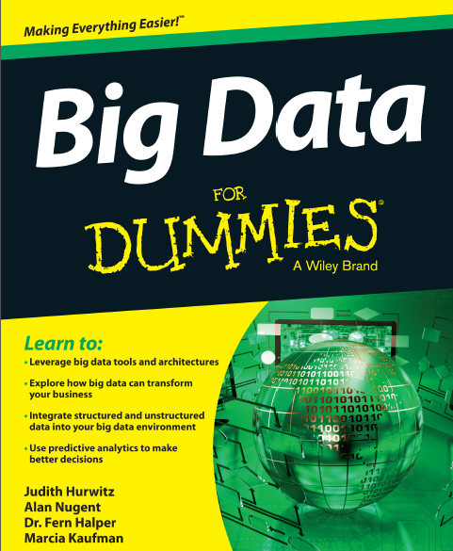
经典文献选读
▼第5章【数据产品及开发】
►如何继续学习
Part I: Getting Started with Big Data
Part II: Technology Foundations for Big Data
Part III: Big Data Management
Part IV: Analytics and Big Data
Part V: Big Data Implementation
Part VI: Big Data Solutions in the Real World
Part VII: The Part of Tens

Slide 8


经典文献选读
▼第5章【数据产品及开发】
►如何继续学习

Slide 9
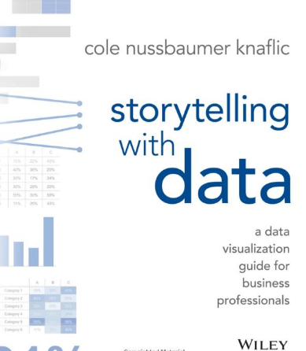
经典文献选读
▼第5章【数据产品及开发】
►如何继续学习
Chapter 1 The Importance of Context
Chapter 2 Choosing an Effective Visual
Chapter 3 Clutter is Your Enemy
Chapter 4 Focus Your Audience’s Attention
Chapter 5 Think Like a Designer
Chapter 6 Dissecting Model Visuals
Chapter 7 Lessons in Storytelling
Chapter 8 Pulling it all Together
Chapter 9 Case Studies
Chapter 10 Final Thoughts

Slide 10
经典文献选读
▼第5章【数据产品及开发】
►如何继续学习
1. What Do We Mean by Data-Driven?
2. Data Quality
3. Data Collection
4. The Analyst Organization
5. Data Analysis
6. Metric Design
7. Storytelling with Data
8. A/B Testing
9. Decision Making
10. Data-Driven Culture
11. The Data-Driven C-Suite
12. Privacy, Ethics, and Risk

Slide 11
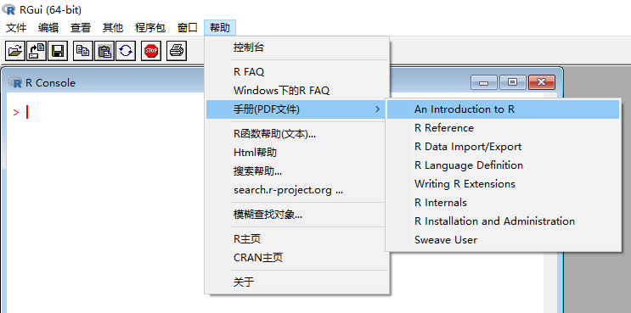

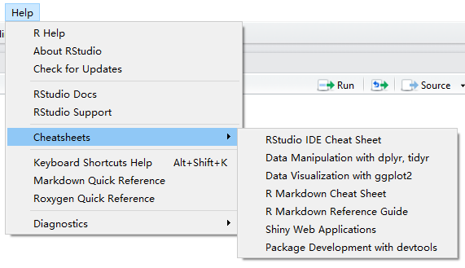

经典文献选读
▼第5章【数据产品及开发】
►如何继续学习

Slide 12

经典文献选读
▼第5章【数据产品及开发】
►如何继续学习

Slide 13
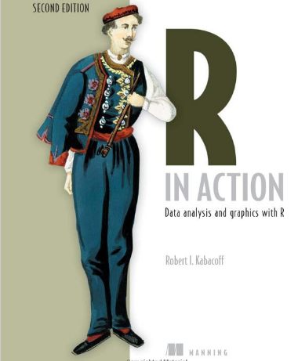
经典文献选读
▼第5章【数据产品及开发】
►如何继续学习
PART 1 GETTING STARTED
Introduction to R /Creating a dataset / Getting started with graphs/Basic data management /Advanced data management
PART 2 BASIC METHODS
Basic graphs/ Basic statistics /
PART 3 INTERMEDIATE METHODS
Regression /Analysis of /Power /Intermediate graphs /Resampling statistics and bootstrapping
PART 4 ADVANCED METHODS
Generalized linear models / Principal components and factor analysis /Time series/ Cluster /Classification /Advanced methods for missing data
PART 5 EXPANDING YOUR SKILLS
Advanced graphics with ggplot2/ Advanced programming /Creating a package/Creating dynamic reports /Advanced graphics with the lattice package

Slide 14
经典文献选读
▼第5章【数据产品及开发】
►如何继续学习
PART 1 INTRODUCTION TO DATA SCIENCE
1 The data science process
2 Loading data into R
3 Exploring data
4 Managing data
PART 2 MODELING METHODS
5 Choosing and evaluating models
6 Memorization methods
7 Linear and logistic regression
8 Unsupervised methods
9 Exploring advanced methods
PART 3 DELIVERING RESULTS
10 Documentation and deployment
11 Producing effective presentations

Slide 15
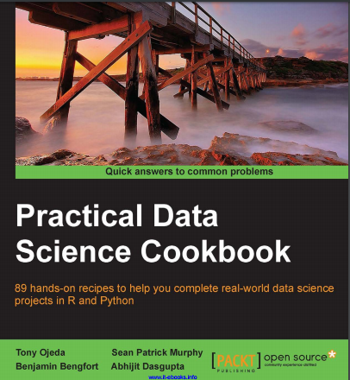
经典文献选读
▼第5章【数据产品及开发】
►如何继续学习
Preparing Your Data Science Environment
Driving Visual Analysis with Automobile Data
Simulating American Football Data
Modeling Stock Market Data
Visually Exploring Employment Data
Creating Application-oriented Analyses Using Tax Data
Driving Visual Analyses with Automobile Data
Working with Social Graphs
Recommending Movies at Scale
Harvesting and Geolocating Twitter Data
Optimizing Numerical Code with NumPy and SciPy

Slide 16


经典文献选读
▼第5章【数据产品及开发】
►如何继续学习
haven: Import and Export 'SPSS', 'Stata' and 'SAS' Files
forcats: Tools for Working with Categorical Variables (Factors)
purrr: Functional Programming Tools

Slide 17

经典文献选读
▼第5章【数据产品及开发】
►如何继续学习
Chapter 4 Package Metadata
Chapter 5 Object Documentation
Chapter 6 Vignettes: Long-Form Documentation
Chapter 7 Testing
Chapter 8 Namespace
Chapter 9 External Data
Chapter 10 Compiled Code
...
Chapter 15 Releasing a Package

Slide 18
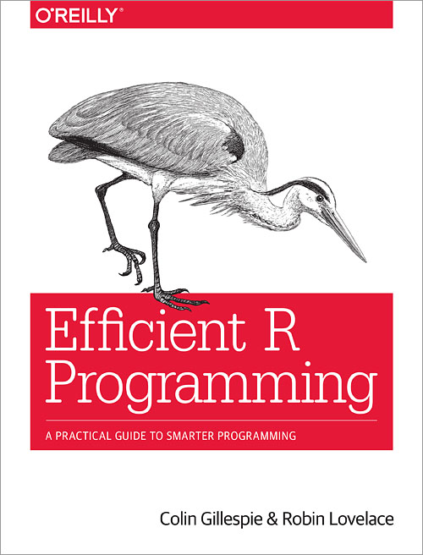
经典文献选读
▼第5章【数据产品及开发】
►如何继续学习
Colin Gillespie is Senior lecturer (Associate professor) at Newcastle University, UK. His research interests are high-performance computing and Bayesian statistics. He is regularly employed as a consultant by Jumping Rivers and has been teaching R since 2005.
Robin Lovelace is a researcher at the Leeds Institute for Transport Studies (ITS) and the Leeds Institute for Data Analytics (LIDA). Robin has many years using R for academic research and has taught numerous R courses at all levels. He has developed a number of popular R resources, including Introduction to Visualising Spatial Data in R and Spatial Microsimulation with R (Lovelace and Dumont 2016). These skills have been applied on a number of projects with real-world applications, including the Propensity to Cycle Tool, a nationally scalable interactive online mapping application and the stplanr package.

Slide 19
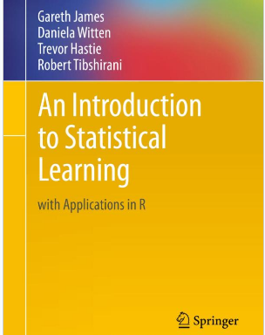
经典文献选读
▼第5章【数据产品及开发】
►如何继续学习
R+
统计学+
机器学习

Slide 20
经典文献选读
▼第5章【数据产品及开发】
►如何继续学习
Working with Different Types of Data in R
Managing Data Structures in R
Importing, Scraping, and Exporting Data with R
Creating Efficient & Readable Code in R
Shaping & Transforming Your Data with R

Slide 21
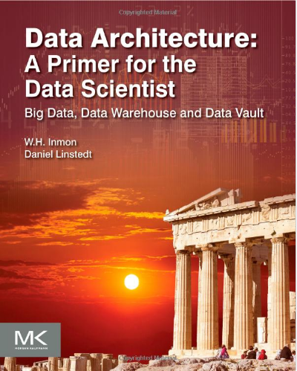


经典文献选读
▼第5章【数据产品及开发】
►如何继续学习
William H. (Bill) Inmon
数据仓库之父
数据架构简史
大数据 已有系统的接口
数据仓库 作业环境接口
数据架构——一种高层视角
Taxonomies

Slide 22
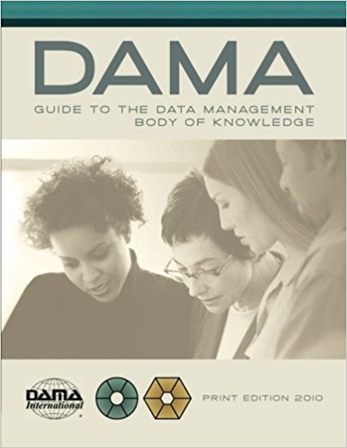
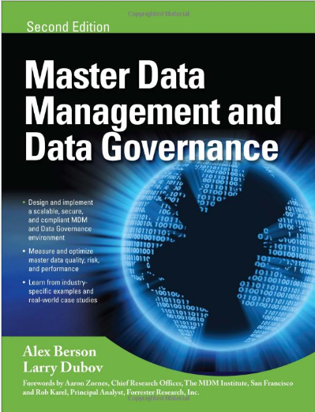
经典文献选读
▼第5章【数据产品及开发】
►如何继续学习

Slide 23
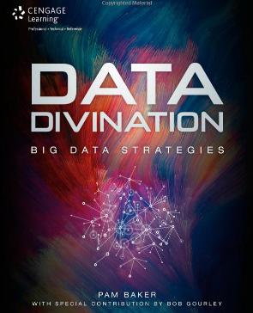
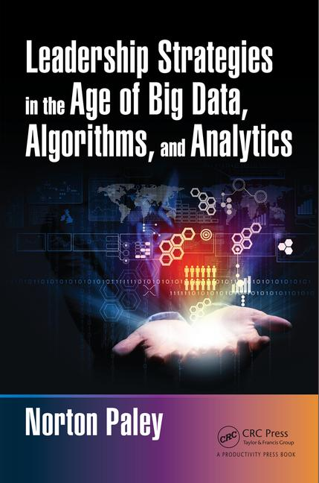
经典文献选读
▼第5章【数据产品及开发】
►如何继续学习

Slide 24



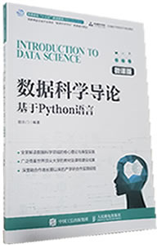
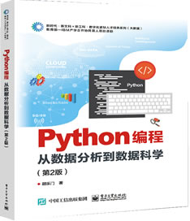
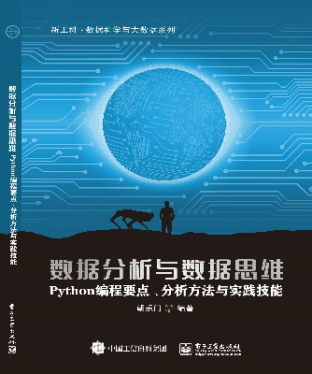
▼第5章【数据产品及开发】
►结束
chaolemen
@
ruc.edu.cn
参考书目
微信公众号
主讲人联系方式
主讲人微信

